Slide 1



Made this happen with

Slide 2
Android Architecture Components
Sanath Nandasiri
☺

Slide 3
Why architecture components?
Well architected app should have
Separation of Concerns
Aliened with SOLID Principles.
Well tested patterns MVC, MVP and MVVM
This will make sure, your app’s
Reusability
Scalability
Upgradability
Manageability
Loose coupling

Slide 4
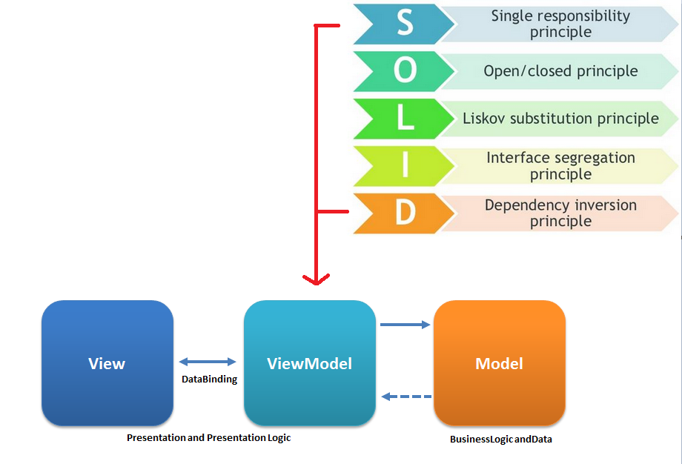
And Android Like…

Slide 5
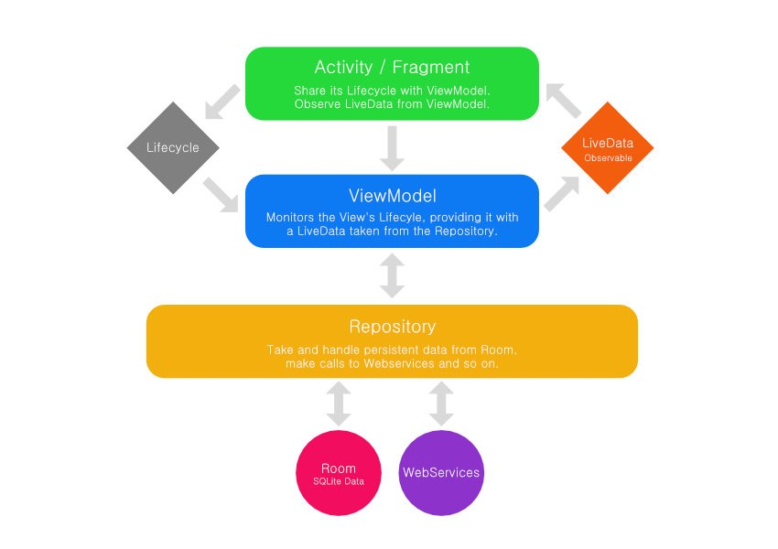
What they recommends…

Slide 6
What are the components
Lifecycle / Lifecycle Owner / Lifecycle Observer
https://developer.android.com/topic/libraries/architecture/lifecycle.html
LiveData
https://developer.android.com/topic/libraries/architecture/livedata.html
ViewModel
https://developer.android.com/topic/libraries/architecture/viewmodel.html
Room
https://developer.android.com/topic/libraries/architecture/room.html

Slide 7
Lifecycle
Lifecycle Owner
Android components with lifecycle (Activities and Fragment)
Lifecycle Observer
Classes that observe lifecycle State/Event of Lifecycle Owner.
Event
Lifecycle event that match with respective event of Lifecycle Owner
State
Current state of Lifecycle Owner

Slide 8
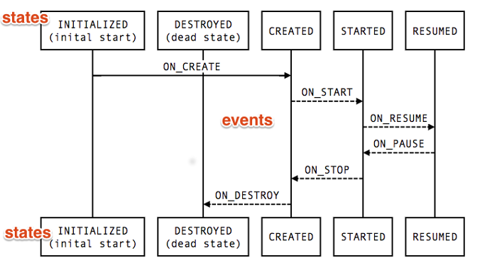
Lifecycle

Slide 9
Enough talk, show something …
Sure… ☺

Slide 10
Wait, Have to add dependencies…
Show dependencies here- todo

Slide 11
So, With Lifecycle
You can code where it should be…
State management can be handle internally.
No hook to Activity or Fragment lifecycle methods.
Makes Activity and Fragments lean as possible...

Slide 12
Living with LiveData<>
It is an Observable lifecycle-aware data holder.
Updates only when attached to active observer(s).
Get up-to-date with configuration changes.
Is removed when Lifecycle Owner destroyed.

Slide 13
LiveData<> vs MutableLiveData<>
LiveData not changing it’s state after creating it.(Immutable)
Use MutableLiveData<> to updatevalue
postValue(T value) from background.
setValue(T value) from MainThread.
MutableLiveData<> extends LiveData<>.

Slide 14
Title and Content Layout with Chart

Slide 15
Two Content Layout with Table
First bullet point here
Second bullet point here
Third bullet point here
Class | Group A | Group B
Class 1 | 82 | 95
Class 2 | 76 | 88
Class 3 | 84 | 90

Slide 16
Two Content Layout with SmartArt
Group A
Task 1
Task 2
Group B
Task 1
Task 2
Group C
Task 1
First bullet point here
Second bullet point here
Third bullet point here

Slide 17
Add a Slide Title - 1

Slide 18
Add a Slide Title - 2

Slide 19
Add a Slide Title - 3

Slide 21
Add a Slide Title - 4

Slide 22
Add a Slide Title - 5

